Slide 1

Techno India NJR Institute of Technology
Udaipur (Raj.)
Session 2021 -2022
4th year CSE
Team - The Achievers
Submitted by
Harshit Paneri (18ETCCS041)
Harshit kasodniya (18ETCCS040)
Harshit jain (18ETCCS039)
Vaibhav soni (18ETCCS093)

Slide 2
E-Commerce Website
About the project :-
1. It's a website for online shopping .
2. Admin maintain whole process of management.
3. Administrator, Users here on this E –Commerce website.
4. Users visit this E –Commerce online shopping website & place order.
5. User must go to website and select products .
6. After finished the order , Product manager delivery the product.

Slide 3
Features-
1. Menu Category
Category list
Product list
2. Category Management
3. Product browsing
4. Shopping cart Checkout
5. Search products
6. Contact us.

Slide 4
1.At Developer End
• Front-end : HTML, CSS, JavaScript , React.js
• Back –end : Node.js, Express.js
• OS : Window 7 or above, Linux or any other
• Database : Mongodb
• IDE : Visual Studio
2.User End
• Any latest web enabled browser

Slide 5
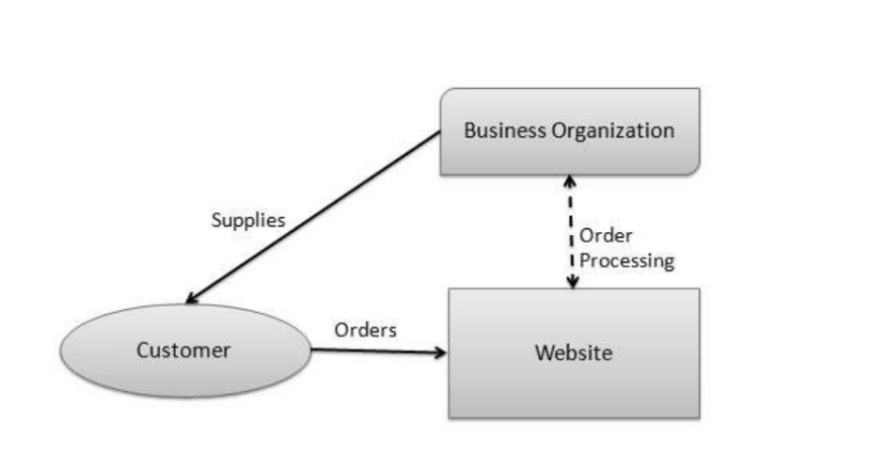
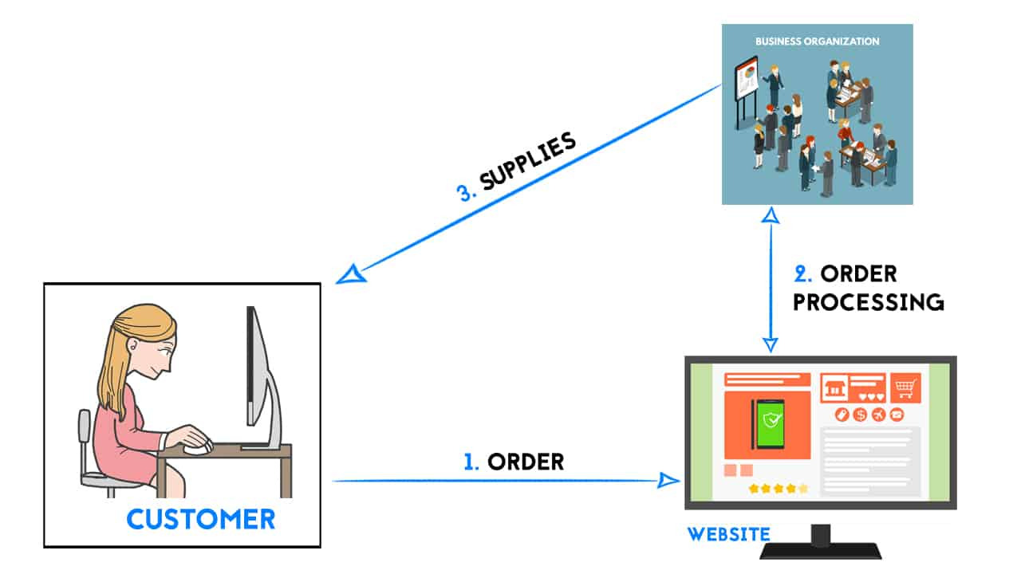
B2C MODEL

Slide 6
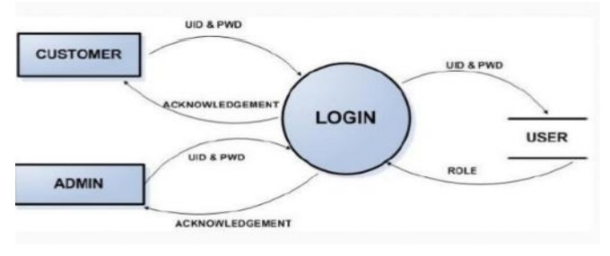
Data Workflow

Slide 7
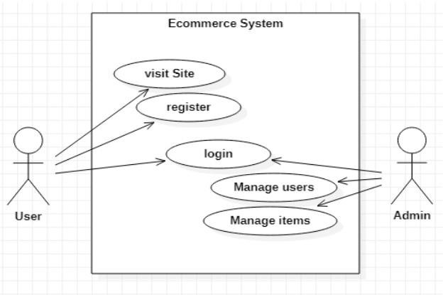
Use case Diagram of Ecommerce

Slide 8

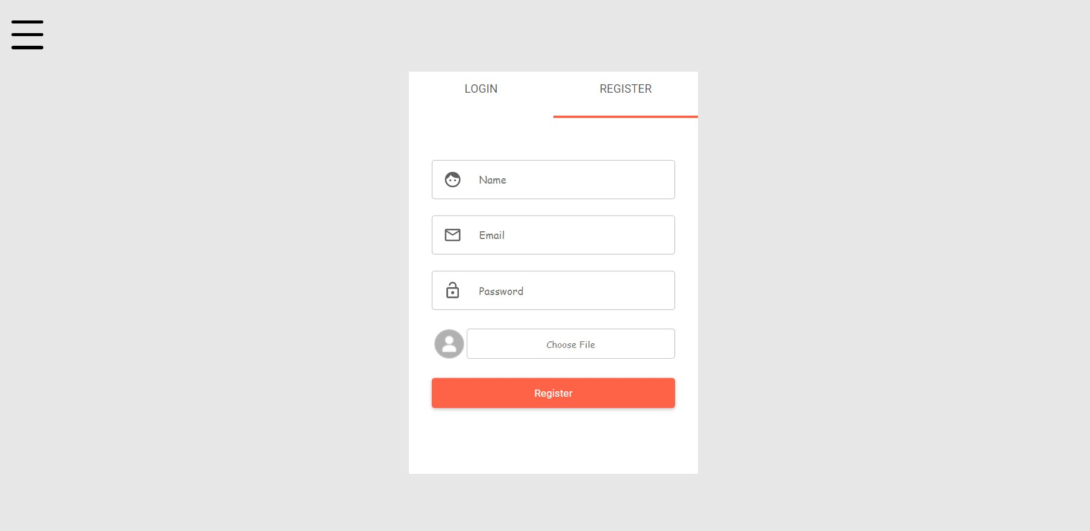
Login And Register Section

Slide 9
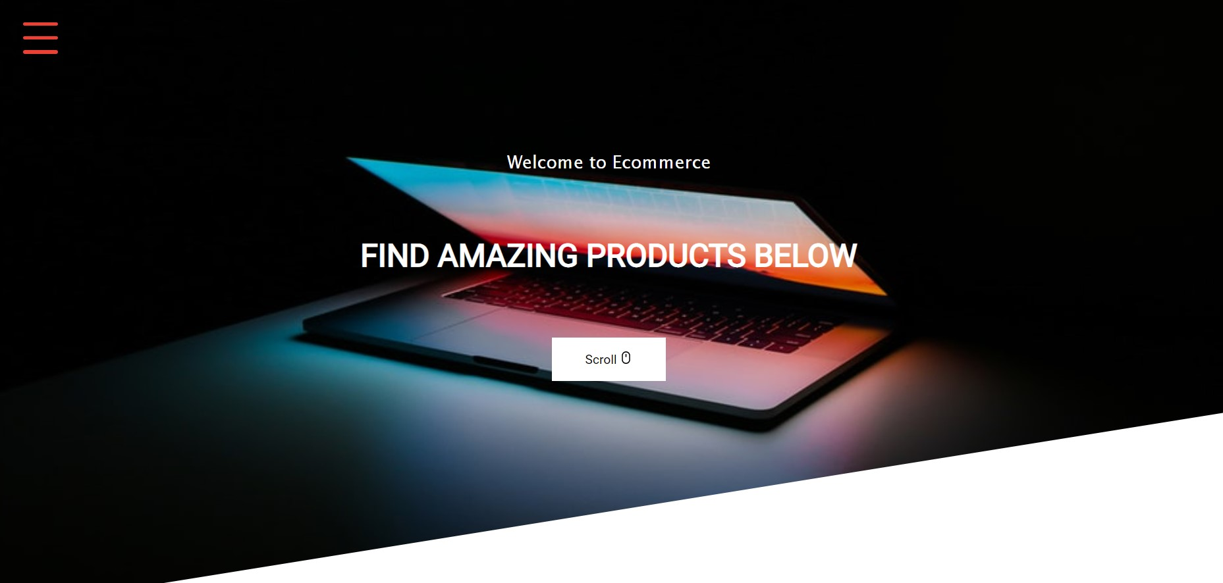
Home Section

Slide 10
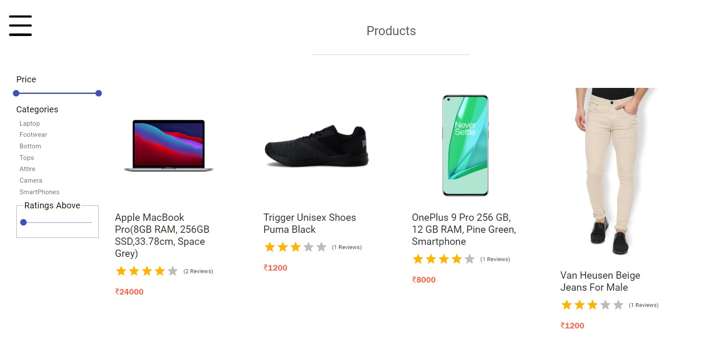
Products Section

Slide 11
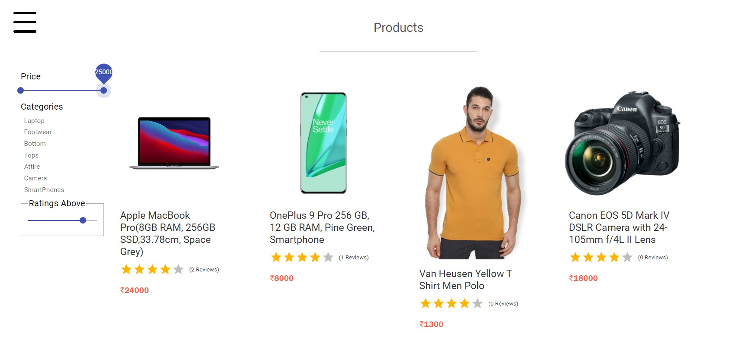
Products Price Section

Slide 12
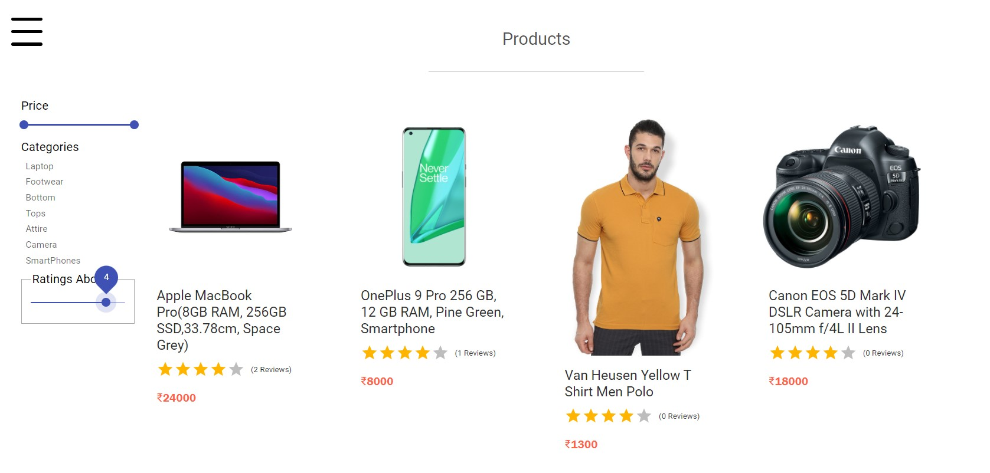
Rating section

Slide 13
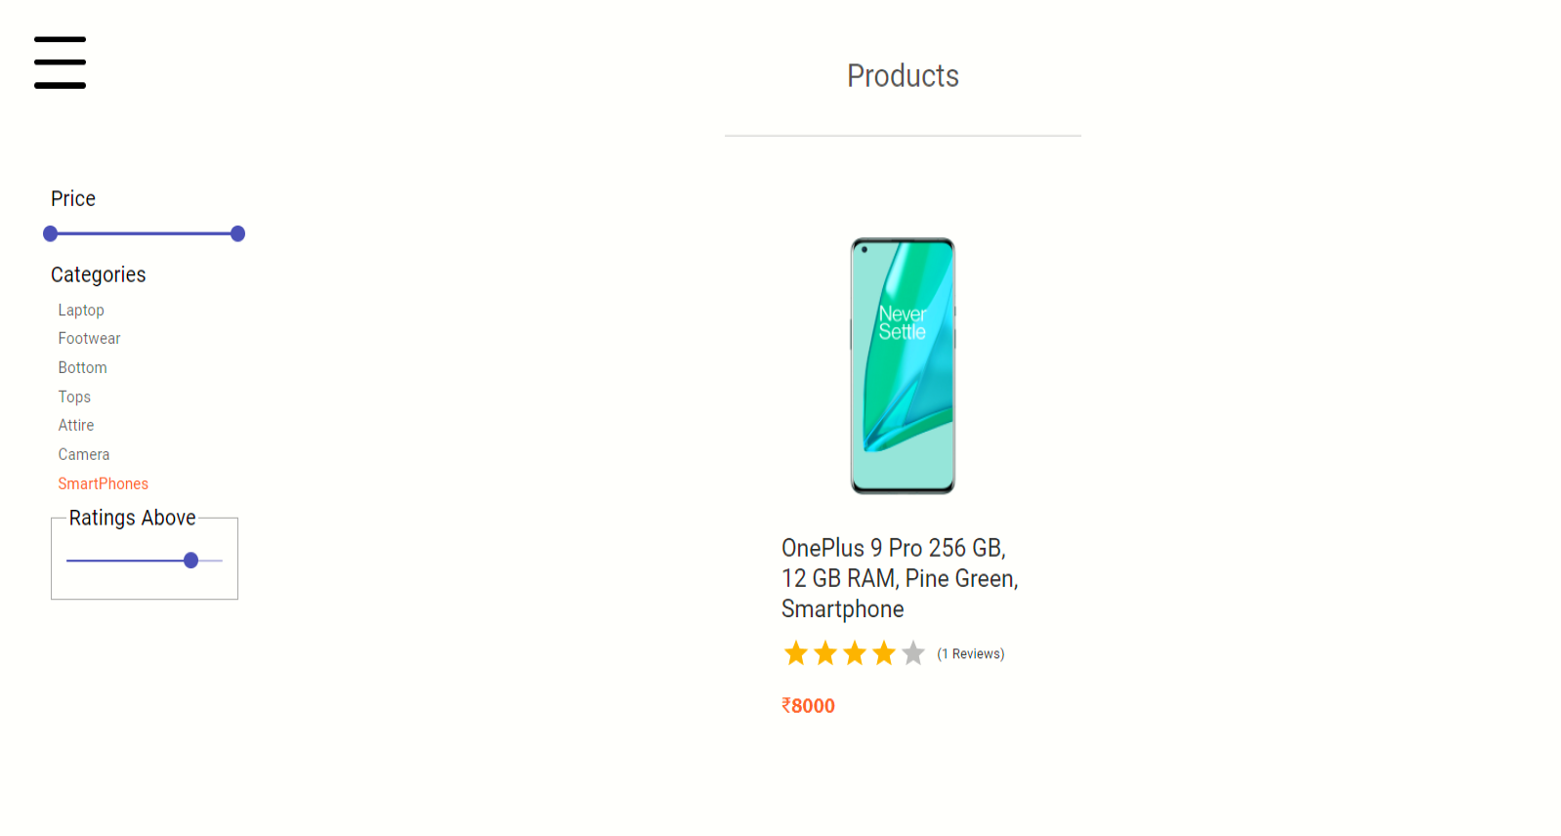
Select the category

Slide 14
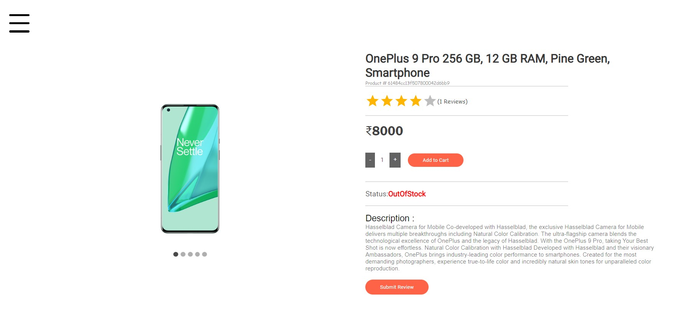
Products Browsing

Slide 15
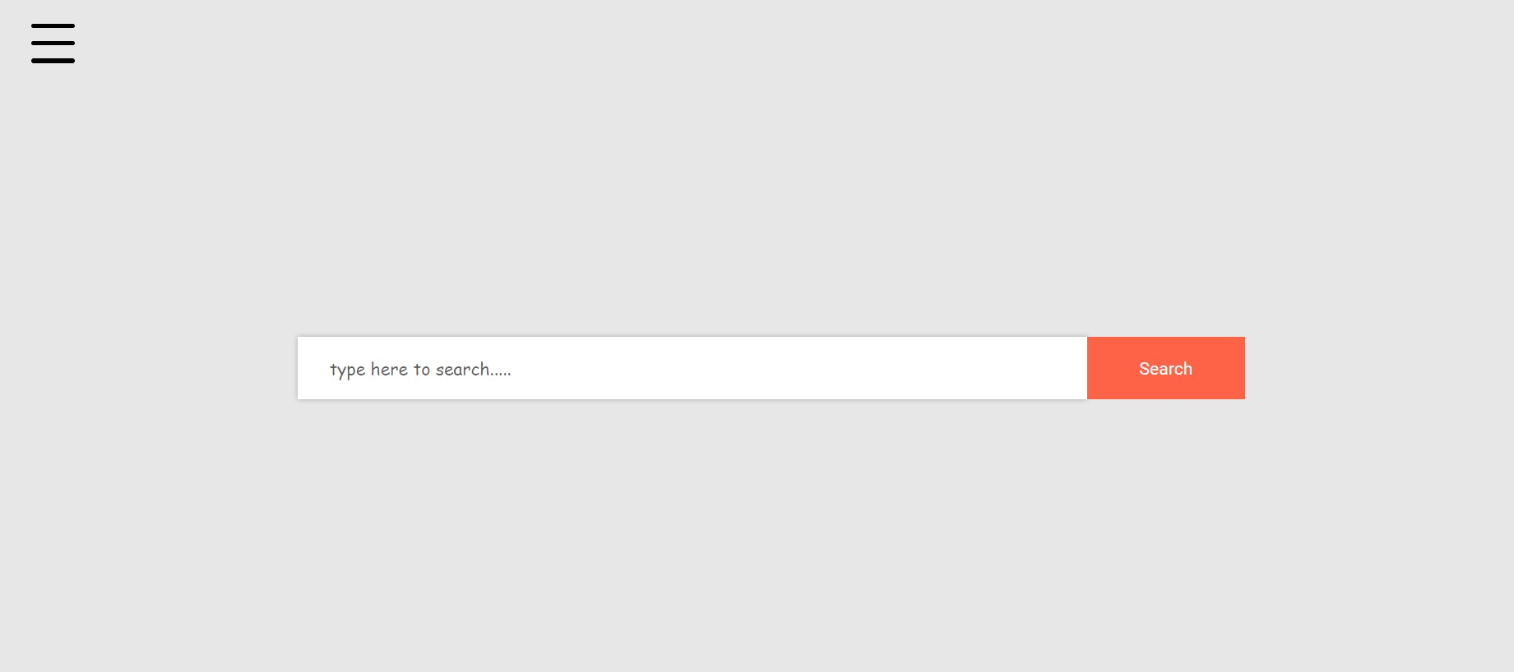
Search products

Slide 16
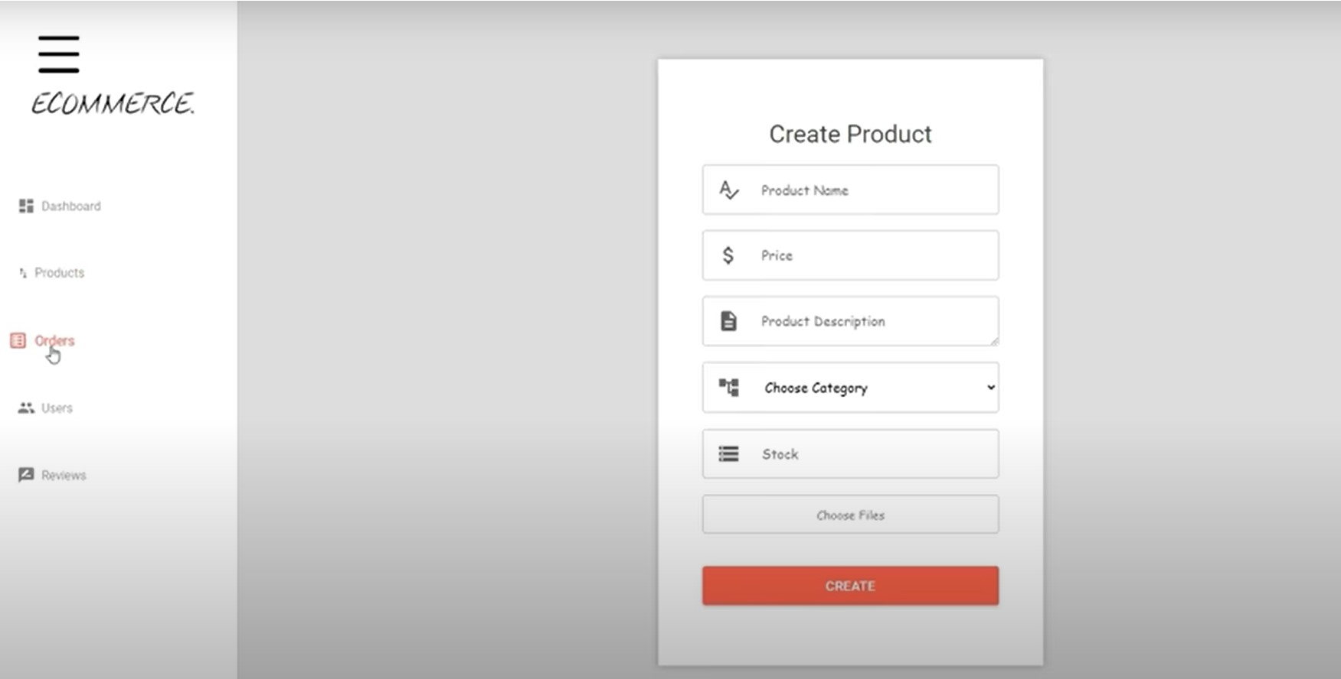
Products Create by Admin

Slide 17
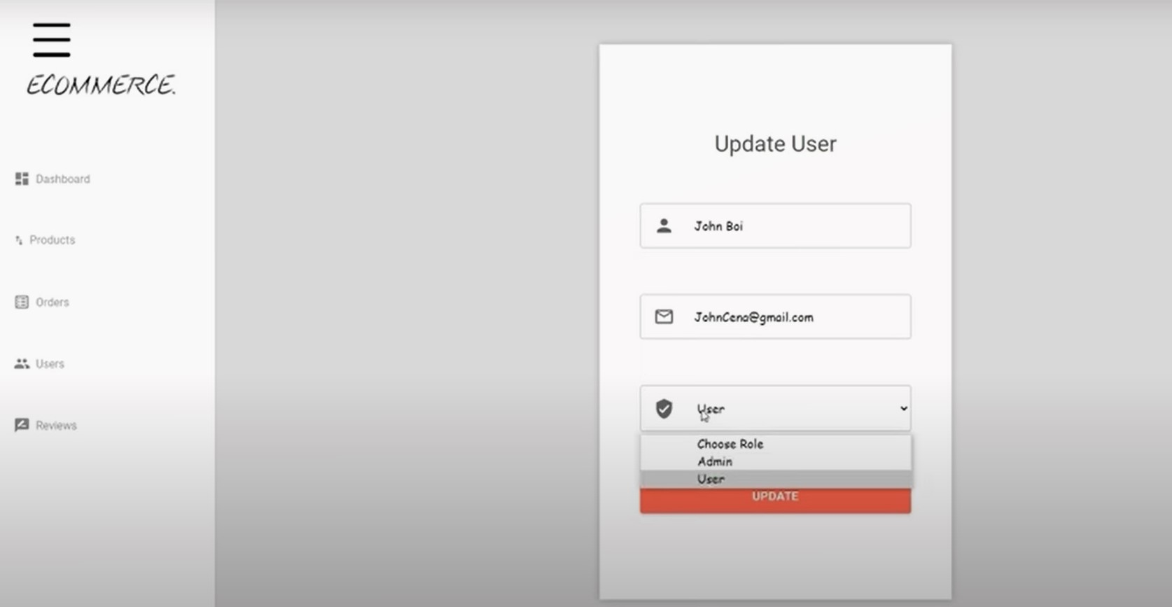
Update Role (Admin)

Slide 18
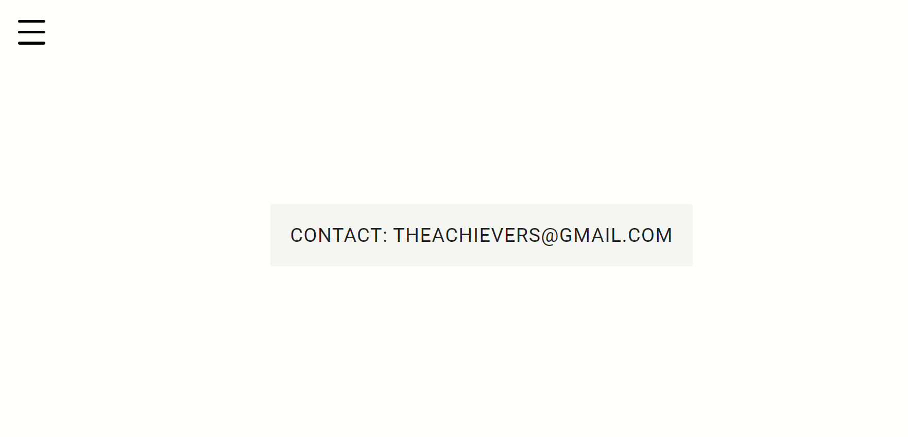
Contact section

Slide 19
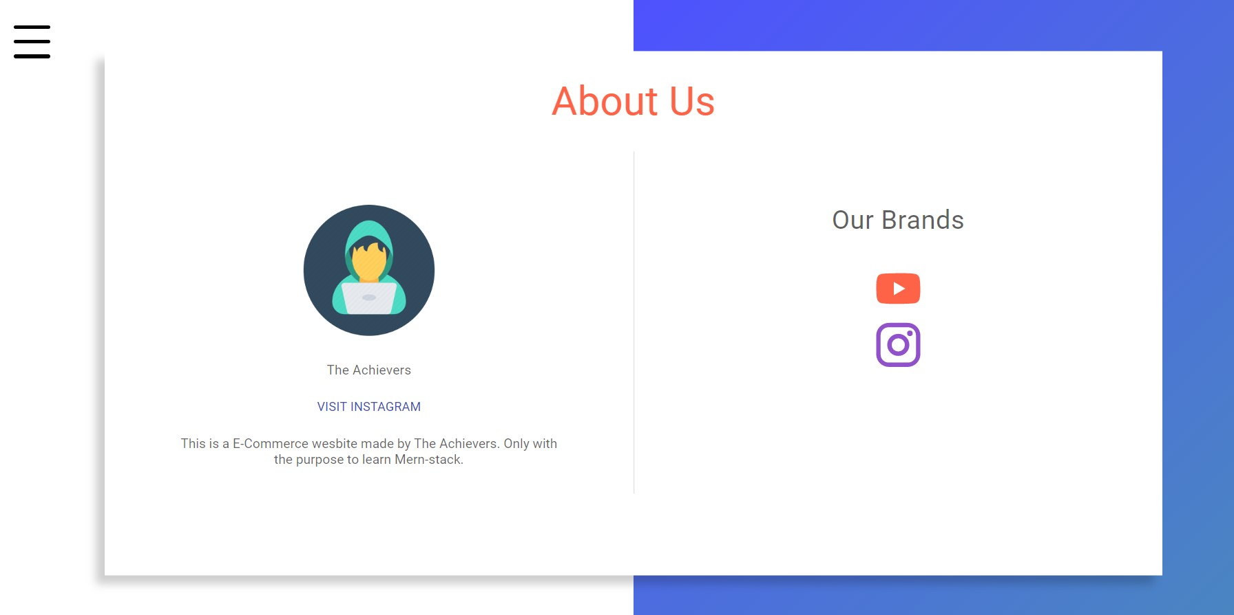
About Section

Slide 20
CONCLUSION -
There are some essential factors which will contribute to the
Terms & Conditions should be clear and product quality should be the same as displayed on the sites.
Today, it is a reality in India. In the last couple of years, the growth of e-commerce industry in India has been phenomenal as more shoppers have started discovering the benefits of using this platform.
There is enough scope for online businesses in the future.
E-commerce industry in India which includes E-Commerce services, payment options, replacement guarantee, location based services, shipment options and quick services.

Slide 21
FUTURE SCOPE
Small stores going online, local marketing and branding may get a further scope.
Low operational costs and better quality of services.
Easy to start and manage a business.

Slide 22
Thank you

